Slide 1
Literature
Introduction to Human Sciences
IIIT Hyderabad
April 11, 2023
Nazia Akhtar

Slide 2
Agenda for this Module
Lecture 1: Literature and Culture
Lecture 2: Culture and Representation
Lecture 3: What is a Classic?
Lecture 4: Comparative Indian Literature

Slide 3
Literature and culture
Lecture 1

Slide 4
Agenda for this Lecture
Reflection, review: the what and why of the Human Sciences
What is culture, and why do we need it?
What is literature, and why do we need it?

Slide 5
The What and Why of Human Sciences
Different scholars across different disciplines study the human condition.
What is the human condition?
What does it mean to be human?
The object of inquiry is not something that is fully formed and complete.

Slide 6
The What and Why of Human Sciences
Important: not only the affective or individual aspect of human experience.
Human beings exist in history, not outside it. We are historical subjects.
Human beings are also economic entities, moving goods and commodities
Humans are also social bodies, operating in human relationships, cultures, and institutions.

Slide 7
The What and Why of Human Sciences
Human behaviour and existence is also political, both individually and collectively.
There is a conceptual understanding of what is a human being. So we exist as an idea or a concept.
Humans also have creative urges and motivations and express these in different media → Literature and the Study of Culture

Slide 8
The What and Why of Human Sciences
The Human Sciences study the entirety of human experience.
There is also no separation between the object of inquiry and the Human Sciences.

Slide 9

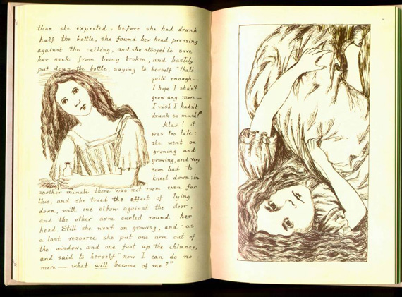
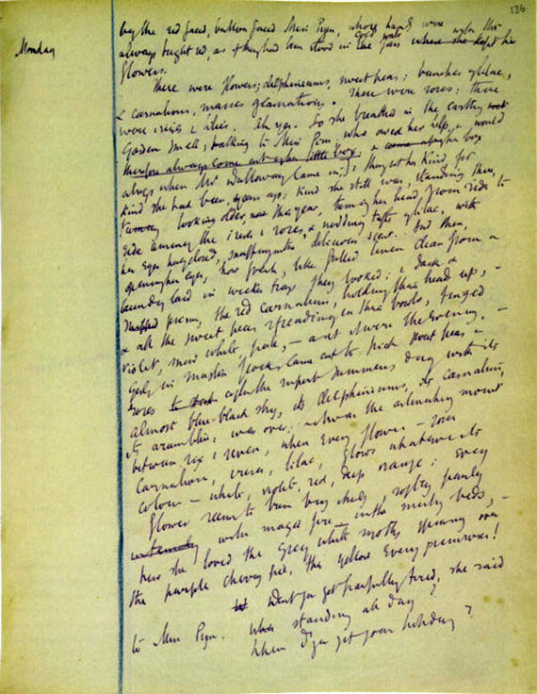
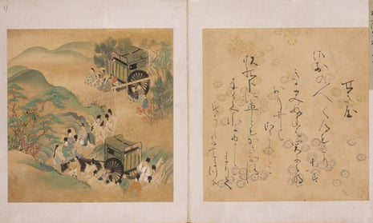
Clockwise:
Draft of Lewis Carroll’s Alice’s Adventures Under Ground
16th cent. Mughal manuscript of the Tales of the Parrot (Tutinama)
Draft of Viriginia Woolf’s Mrs. Dalloway
Lost chapter of Murasaki Shikibu’s The Tale of Genji
What does Literature Study?

Slide 10
What do literary scholars study?
Human creative expression, usually in the form of writing.
This is also called Literature.
Fiction allows us to imagine other worlds, puts us into someone else’s shoes, offers insights into experiences we will never directly access.

Slide 11

What would life be like a thousand years from now on another planet when technology has reached its zenith?

Slide 12
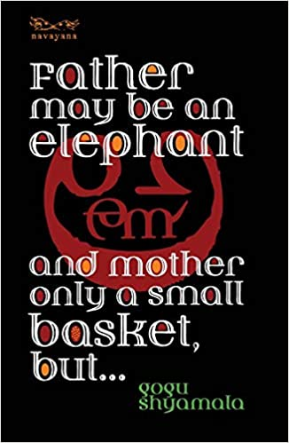
How does a Dalit woman depict life? What are the images and metaphors in which she represents/interprets the world, and how do those of us who do not have access to her lived experience interpret these words and phrases?

Slide 13

How did Victorian British society react to a wandering widowed woman of science who did not believe in “dragons”?

Slide 14
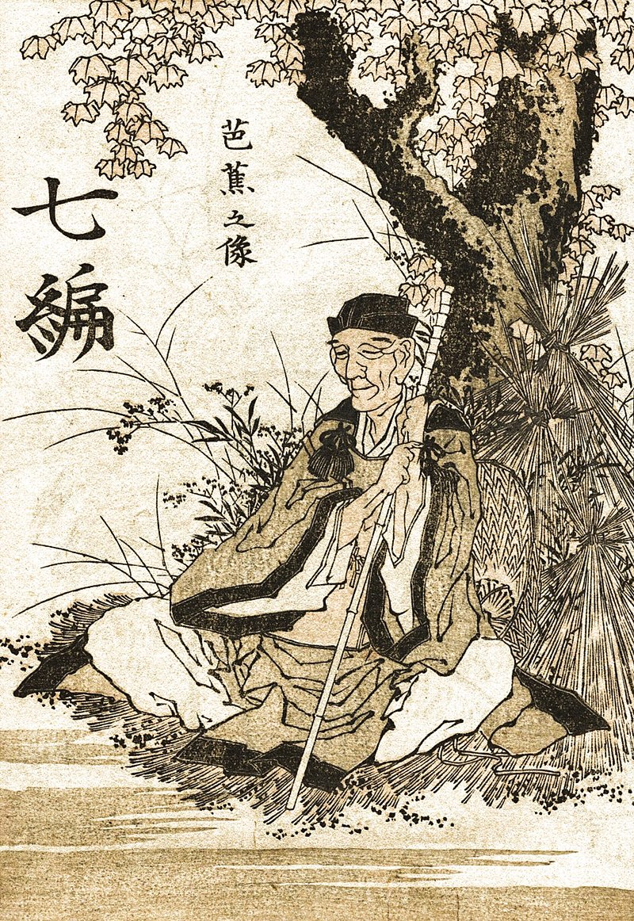
“pears, plums, black cherries:
for how long, when iron rods
are pointing at the sky?”
- Kynpham Sing Nongkynrih

Slide 15
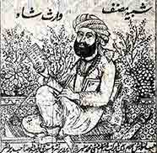
What was the pre-Partition definition of Punjabiyat (“Punjabi identity”), and who sang its songs?

Slide 16
What do literary scholars study?
Literature voices/expresses (represents) the human condition.
There are other imaginations of the human experience apart from ours: some around us, some distant from us.
Again, continuity between the object of inquiry and society.

Slide 17
What do literary scholars study?
As literary scholars, we think critically, interpretively, creatively, imaginatively
What is written? How is it written? What are the different ways in which it can be read? What are its possibilities?
Put questions to fiction and interpret it to examine the human condition
The Human Sciences give us the training, conceptual framework, and language to think about “us” and “others”

Slide 18
What is Culture?
Different but related meanings of the word “culture.”
cultural practice and production
the relationship between human experience, everyday life, social relations, and power
Culture is constantly produced and reproduced.
All cultural productions and artefacts must be read as emerging from a particular context (social, historical, political)
They either challenge or reproduce/endorse existing worldview.

